Slide 1


CASE STUDY • #MRUCHACIRCLE • SKINCARE-INFUSED MAKEUP
Mrucha
Beauty
Clean, cruelty-free D2C for diverse Indian skin tones
Your Shade, Your Story
PRESENTED BY
DATE
Raheen Pathan
Sep 2026
SUBMITTED TO
BRAND
Mr. Sanchit Khandelwal
mrucha.com
https://mrucha.com

Slide 2
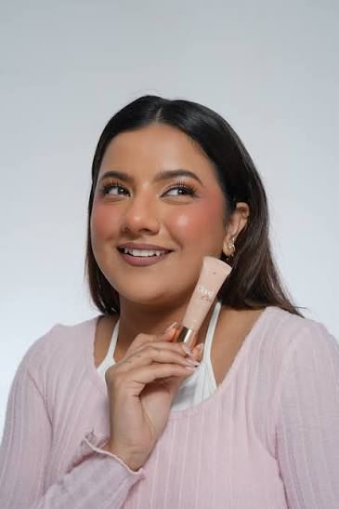
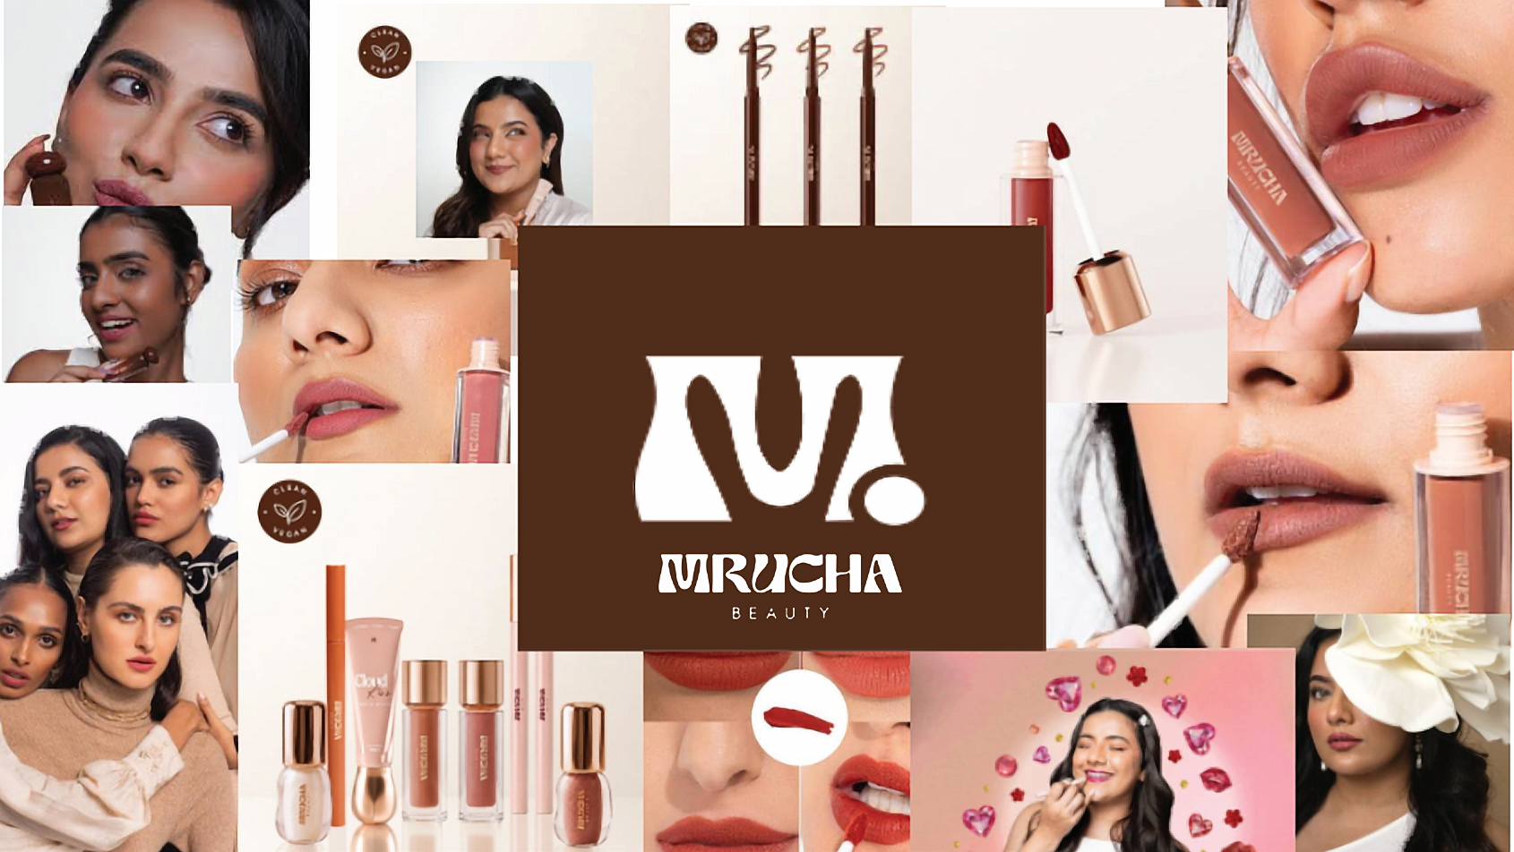
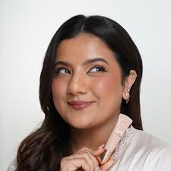
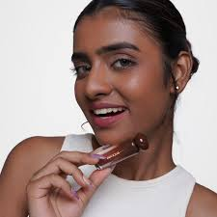


Slide 3
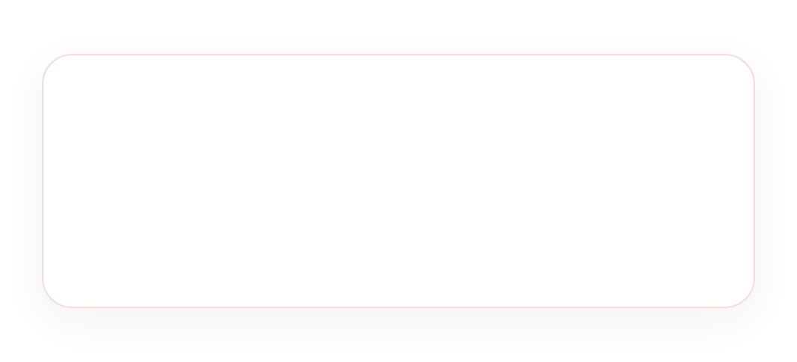







OVERVIEW
What is this Case Study About?
TRACTION
₹2 Cr
SALES IN 5 MONTHS
Nov 2024 launch se Feb 2025 tak organic growth
Ye case study Mrucha Beauty ke baare mein hai — ek naya Indian makeup brand jo famous creator Mrunal Panchal (Mrunu) ne launch kiya hai.
Creator-led D2C brand kaise 5 mahine me ₹2 Cr sell karta hai — uski community strategy, gaps aur growth playbook.
REACH
6M
1 Brand kya hai + kaise shuru hua
FOUNDER FOLLOWERS • @MRUNU
2 Problem & Gaps kya hai
Built-in focus group & distribution channel
3 Customer, Competitors kaun hain
4 Digital marketing + Learning
LAUNCH
Nov 2024
OFFICIALLY LAUNCHED • JAN 2024 INC.
D2C via mrucha.com • Clean & cruelty-free

Slide 4
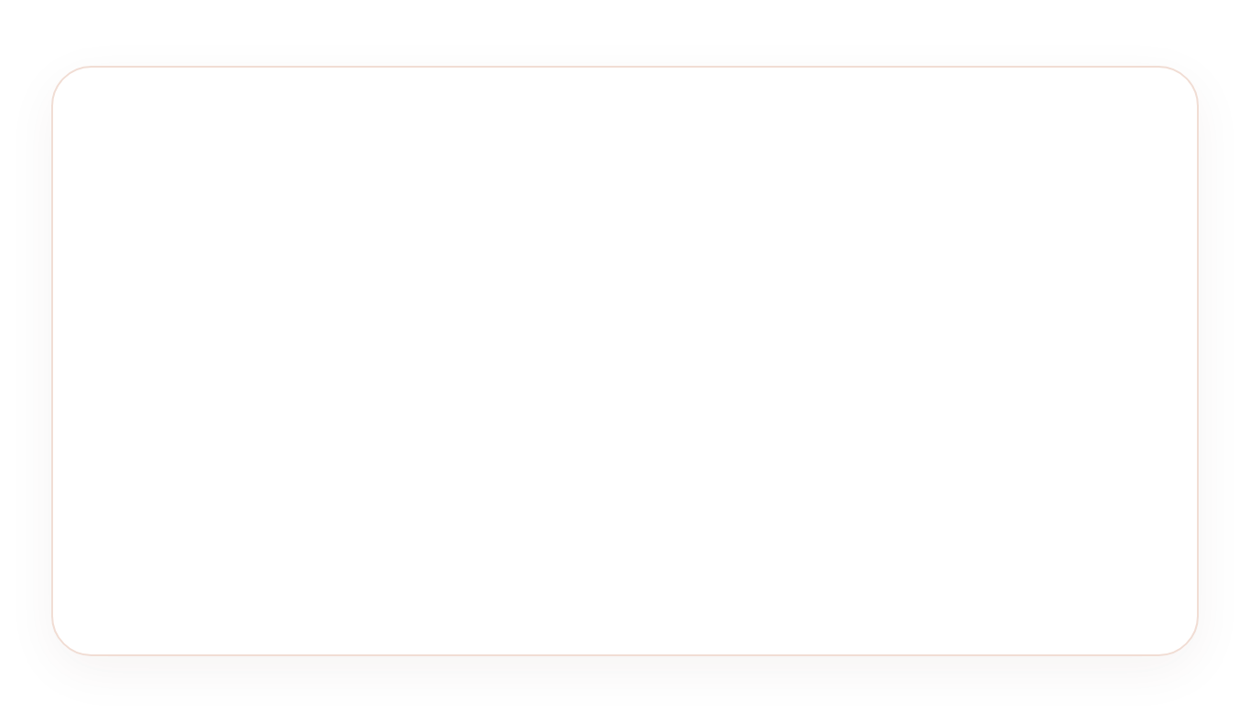








BRAND STORY — SIMPLE WORDS MEIN
Skincare + Makeup, Indian Skin Ke Liye
Mru + Cha = Mrucha
Mrunal Panchal 26yr • 5.5M IG
Mrucha Beauty kya hai?
Kya Special Hai (USP)?
Makeup jo skincare ingredients ke saath — lipstick sirf color nahi, nourish bhi karta hai. Peptides, Hyaluronic, Shea & Kokum Butter.
Indian skin tones ke liye banaya
Skincare + Makeup ek saath
Peptides
Hyaluronic
Shea Butter
Kokum
Cruelty-free, Clean beauty
Kab launch hua?
Price ₹389-₹1,649 Affordable Luxury
Company Jan 2024 registered • Products Nov 2024 launched — 5 mahine me ₹2Cr sales, Hurun ranking.
Creator-led authenticity
Kaun banaya?
Mrunal Panchal (Mrunu) — 26yr creator, 5.5M IG, Hurun Top Founder 2025 + Anirudh Sharma Co-founder.
₹2Cr
5 mahine me sales
Strong PMF proof • Loyal Mrucha Circle

Slide 5
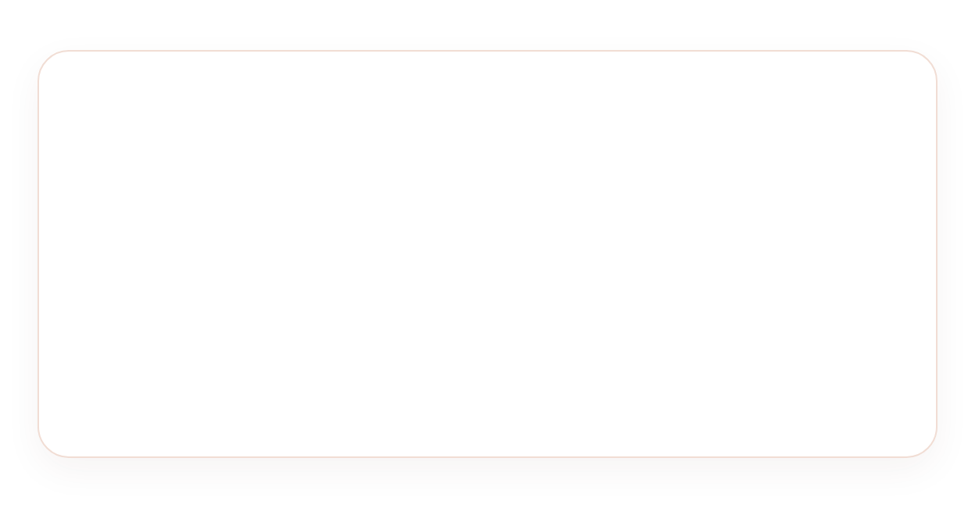



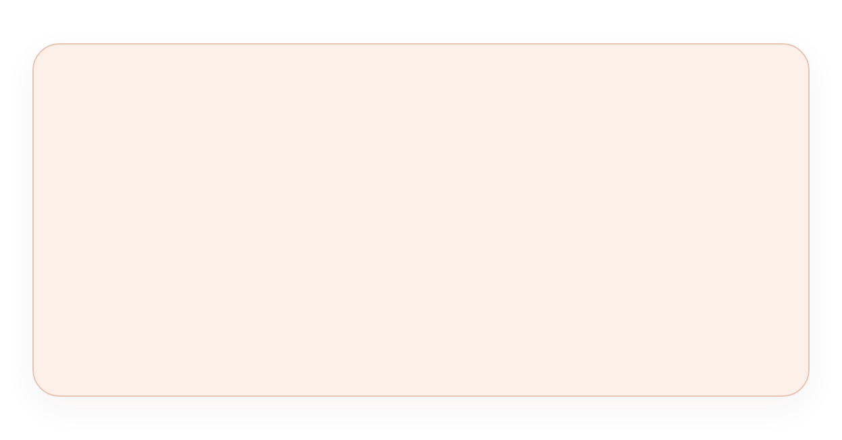


CHALLENGE AUDIT
Problem Kya Hai? 4 Key Gaps
PROBLEM 01
PROBLEM 02
Founder Dependency
No Funding vs Giants
Sirf Mrunal ke naam pe chal raha hai. Content = product marketing, single point of failure. Brand ko apni alag pehchaan banana hogi.
Mamaearth $89M, Pilgrim $50M, MCaffeine $50M — Mrucha unfunded. 4,325 competitors me lean organic growth hi raasta.
PROBLEM 03
PROBLEM 04
Mixed Reviews
Only Online — No Omnichannel
Reddit / IG pe mixed — “Toastie & Whimsical didn't work”. Shade issues ko publicly handle karna zaroori, perception critical.
D2C only via own site. No offline, no Amazon/Flipkart. Discovery limited, non-digital-native tak reach mushkil.

Slide 6
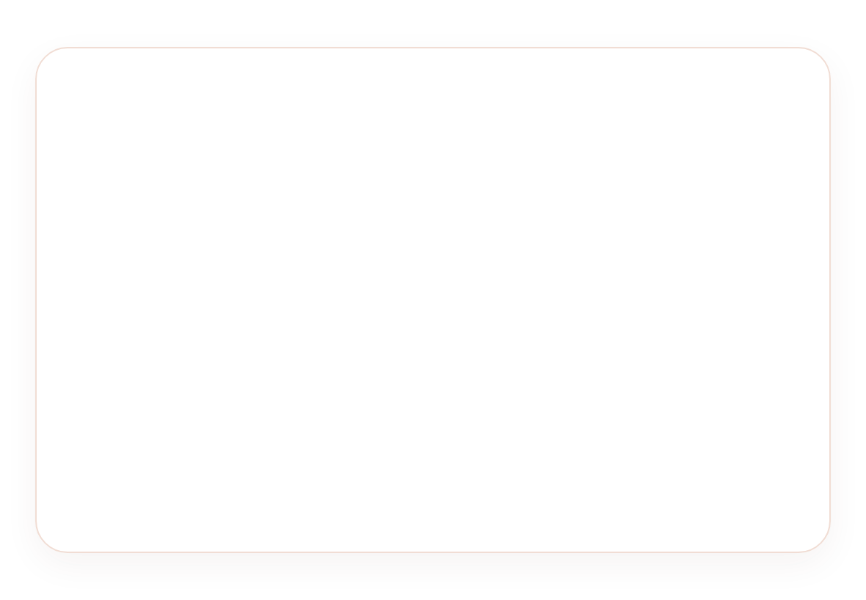
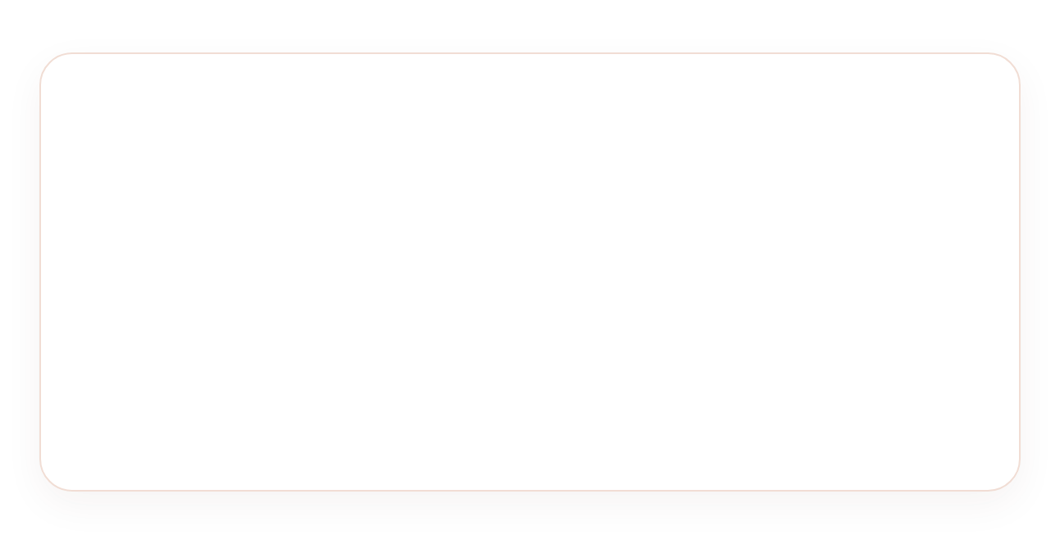









TARGET AUDIENCE + BUYER PERSONA
Customer Kaun Hai?
Gen Z core 18-30 • Tier 1 & 2 • Aspirational but value-conscious
Aanya, 23
Target Audience Dimensions
A
Bangalore • Junior Graphic Designer • ₹35k/mo
AGE
18-30 core Gen Z, secondary 30-35
BEHAVIOUR
LOCATION
Mumbai, Delhi, Bangalore, Pune — Tier 1 & 2
IG beauty creators follow, YouTube reviews, Reddit honest opinion dhundhti hai
INCOME
₹20,000-₹60,000/month individual
PAIN POINT
MOTIVATION
Self-expression, community, creator-led support
Trendy Western makeup chahiye par ₹2,000 afford nahi. Indian skin ke liye shade sahi nahi milta.
IG Primary
YouTube
Reddit
WHY BUY MRUCHA?
Mrunal pasand + Indian skin tones + real reviews + ₹389 se start
Insight: Aanya ko Western vibe @ ₹499 chahiye — Mrucha aspirational + affordable balance.

Slide 7
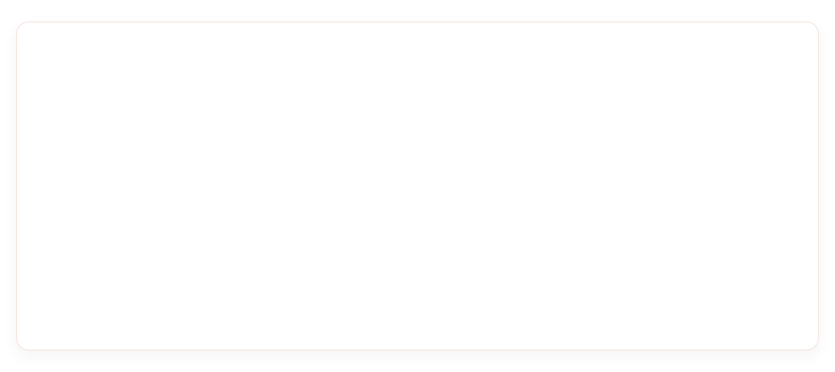





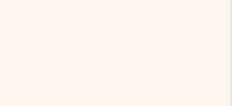













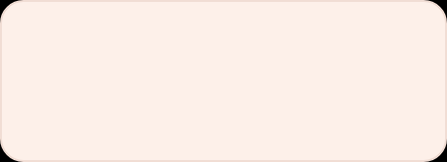

COMPETITOR ANALYSIS
Competitors Kaun Hain?
PARAMETER
MRUCHA BEAUTY
MAMAEARTH
PILGRIM
MCAFFEINE
Positioning
Skincare-infused makeup, Gen Z
Toxin-free beauty
Multi-category natural
Caffeinated skincare
Funding
Unfunded
$89.3M
$50M
$50.6M
Price Range
₹389–₹2,099
₹199–₹999
₹350–₹1,500
₹199–₹999
Key Strength
Founder trust, shade diversity
Mass distribution
Natural ingredient story
Caffeine proposition
Key Weakness
Limited scale, founder dep.
Premium perception gap
Less Gen Z resonance
Narrow category
IG Focus
Community-led UGC-heavy
Campaign, celebrity
Educational
Meme-heavy
💡
Key Insight
✓ FAYDA
✗ KAMZORI
Mrucha advantage authenticity + community. Competitors have scale, but Mrucha can win via creator relatability, 5.5M audience & feedback loops. 4,325 competitors — differentiation is moat.
5.5M audience • Honest community • Indian skin specific
Chhota scale • No funding • Only online

Slide 8







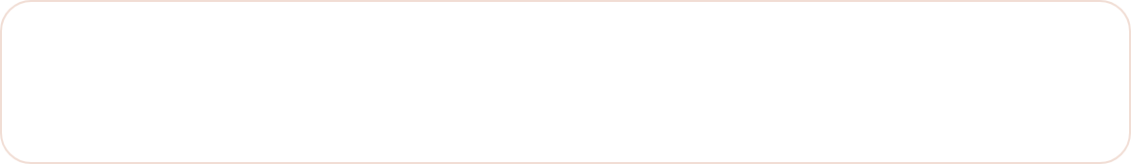
ONLINE PRESENCE AUDIT
Digital Presence —
Online Kahan Hai?
mrucha.com • 294 reviews on Brew
STRONGEST
D2C
FOUNDER-LED
LIMITED
Instagram — 6M+ Founder
Website — mrucha.com
YouTube — Tutorials
Facebook — Cross-post
@MRUNU • REELS + UGC
RAZORPAY • COMMUNITY
FOUNDER CONTENT DOMINANT
NOT GEN Z PRIMARY
Brand leverages founder audience; brand account smaller but Mrucha Circle active. Gen Z primary.
Strong product detail, ingredient transparency, active review system.
Reviews, unboxings, GRWM. Brand channel unclear — opportunity.
Limited presence, secondary. Low ROI for TG 18-28.
✅ ACHHI BAAT Mrucha Circle community = retention asset. 294 reviews on single product show deep engagement.
⚡ SUDHAAR KI ZAROORAT Brand ka apna Instagram identity strong karna hoga Mrunal ke personal ke alawa.

Slide 9
Brand USP & Positioning
💧
🎨
✨
SKINCARE-INFUSED MAKEUP
MADE FOR INDIAN TONES
AFFORDABLE LUXURY
The source case study highlights peptides, hyaluronic acid, shea butter and kokum butter across its product story.
Positioning focuses on Indian skin tones and shade relevance rather than generic global beauty messaging.
The supplied price range of ₹389–₹1,649 supports an accessible-premium / aspirational proposition.
👥 COMMUNITY-LED
#MruchaCircle turns customer feedback and UGC into a potential brand asset beyond the founder - real reviews, real trust, real growth.
COMMUNITY-LED
#MruchaCircle turns customer feedback and UGC into a potential brand asset beyond the founder. real reviews, real trust, real growth.

Slide 10
Why This Brand Stands Out
Brand USP
& Positioning - 2
◍ SKINCARE + MAKEUP
Peptides • Hyaluronic • Shea • Kokum
◍ INDIAN TONES FIRST
Skincare-infused makeup made for Indian tones at affordable luxury
Not global shade copy - built for us
◍ ₹389 - ₹1,649
Aspirational yet accessible pricing
◍ #MruchaCircle
Community-led UGC & feedback loop

Slide 11
THE FORMULA STORY
Skincare Meets
Makeup
PEPTIDES
HYALURONIC
Firm & Repair
Deep Hydration
✓ Skin barrier support
✓ Suitable for Indian climate
✓ Skin barrier support
✓ Suitable for Indian climate
Not just color, but care. Each product is powered by skin-loving actives that Indian skin needs.
SHEA BUTTER
KOKUM BUTTER
Nourish & Soften
Indian Superfood
✓ Skin barrier support
✓ Suitable for Indian climate
✓ Skin barrier support
✓ Suitable for Indian climate

Slide 12


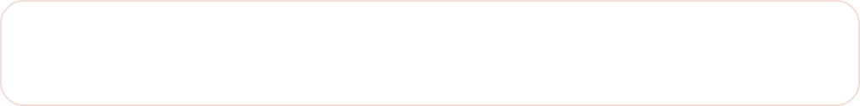





CAMPAIGN IDEA
Marketing Strategy — #MruchaCircle
Content Buckets — Your Shade, Your Story
5 MIX
Educational
30%
Ingredients, layering, tone-match
Community
25%
CAMPAIGN HOOK
UGC, Mrucha Circle spotlights
“Makeup that loves your skin back. Skincare-infused. Made for your tone. Built with you.”
Entertainment
Trending reels, meme relatability
20%
Product Edu
15%
PLATFORMS
Launches: Freckle Pen, Aura
Instagram — Primary
BTS
10%
Reels, Stories, Carousels, UGC
Mrunal journey, feedback→launch
YouTube — Founder-led
Goal: Build brand equity beyond founder via UGC + Circle.
GRWM tutorials, shade story
Reddit r/IndianMakeupAddicts
Honest feedback loop

Slide 13



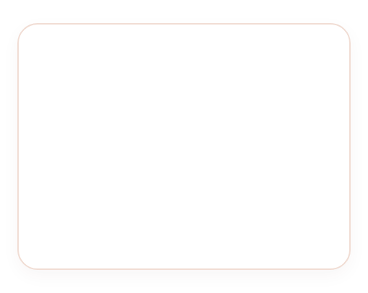
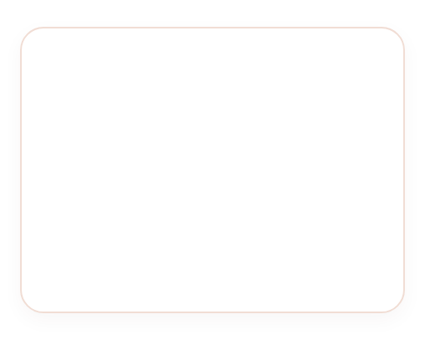

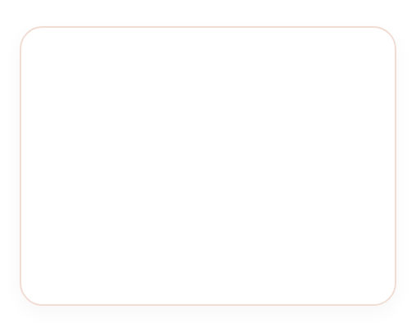



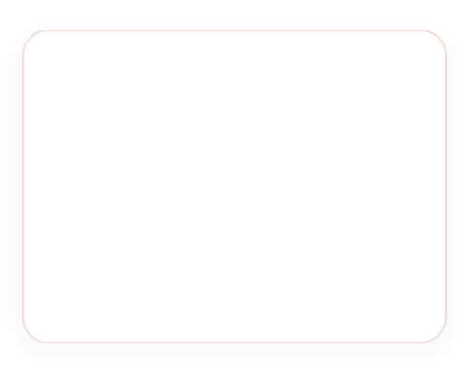
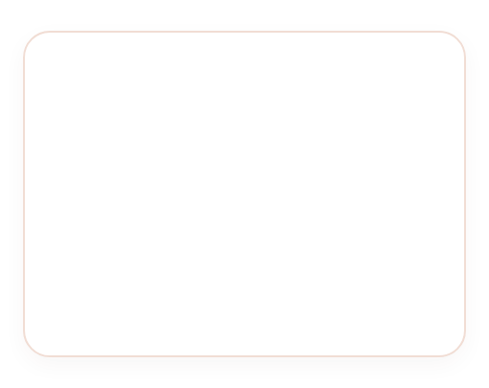


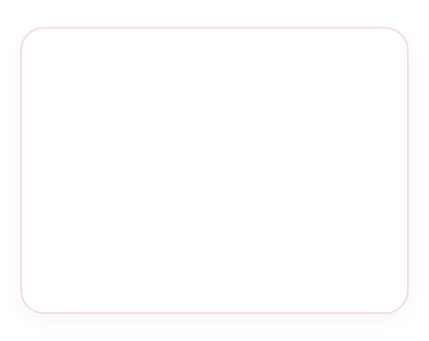







CONTENT CALENDAR — 15 DIN KA PLAN
Consistent Storytelling
IG Primary
YT / Reddit
Focus: UGC + Edu
DAY 01
DAY 02
DAY 03
DAY 04
DAY 05
REEL • 30S
STORY POLL
CAROUSEL
REEL UGC
YT SHORT
Lipstick skincare bhi hona chahiye
Brew vs Sparkling?
5 ingredients in lip
Mrucha Circle speaks
Feedback se shade
Peptides demo hook
Shade vibe poll
Edu breakdown
Reviews comp
Mrunal story
DAY 06
DAY 07
DAY 08
DAY 09
DAY 10
REEL GRWM
CAROUSEL
STORY Q&A
REEL B/A
REDDIT
Trending audio GRWM
Aura Palette 3 looks
Ask Mrunu anything
Before/After lips
Feedback suna, badla
Product place
Day to night
Skincare-makeup
Melts transform
Transparency
DAY 11
DAY 12
DAY 13
DAY 14
DAY 15
CAROUSEL
REEL BTS
YT SHORT
REEL TEASER
ALL RECAP
Faces of Mrucha Circle
Freckle Pen making
Lip combo kaise
Naye product hint
Weekly recap + CTA
Member spotlight
Dev story
Layering tut
Drop date
Top moments Shop
Rhythm: 30% Edu • 25% Community • 20% Entertainment • 15% Product • 10% BTS • Goal: UGC loop + brand equity
Reels 7
Carousel 3
Story 2 + YT 2 + Reddit1

Slide 14
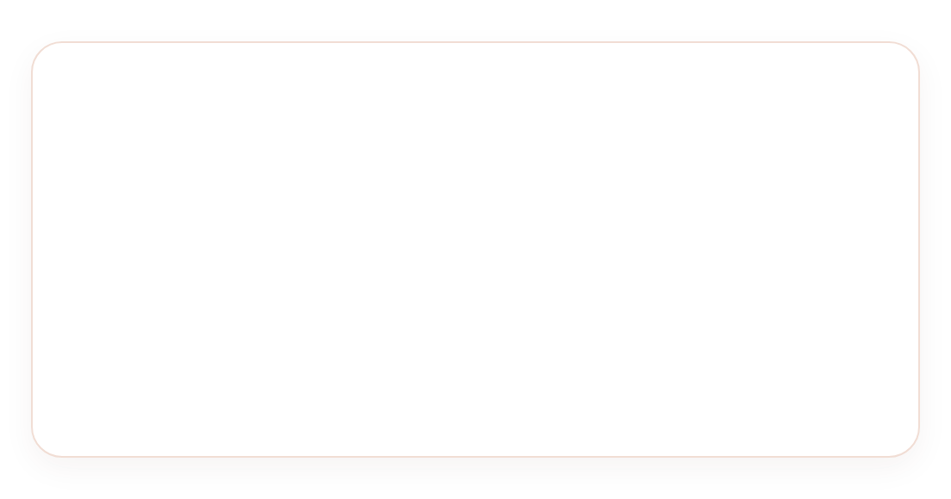


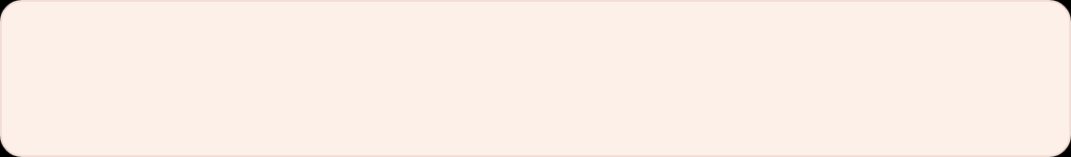







CREATIVES & AD COPY
Visuals that Convert —
Real Skin, Real Reviews
Platform: IG Reels / Stories / Carousels
Style: Clean girl, skincare-first
VISUAL MOCKUP IDEAS
SAMPLE CAPTIONS
Clean flat-lays w/ ingredient callouts
Pastel backdrops, Peptides / Hyaluronic tags
EDUCATIONAL — LIP MELTS
Real people, real skin — diverse Indian tones
“Your gloss shouldn't just look good. Peptides heal. Hyaluronic plumps. Shea nourishes. That's Mrucha. 💋”
Natural light, no over-retouch, brown skin shades
UGC phone-shot reviews
Authentic, not overproduced — iPhone light
COMMUNITY — CIRCLE
Before / After + Founder direct-cam
“When Mrucha Circle speaks, we listen. 🗣 Your feedback shaped our shades. Tag us → #MruchaCircle”
Lip transformation split + Mrunal product-in-hand
HASHTAGS
#MruchaBeauty
#MruchaCircle
#SkincareInfused
#CleanBeautyIndia
#GenZBeauty
#MadeForIndianSkin

Slide 15

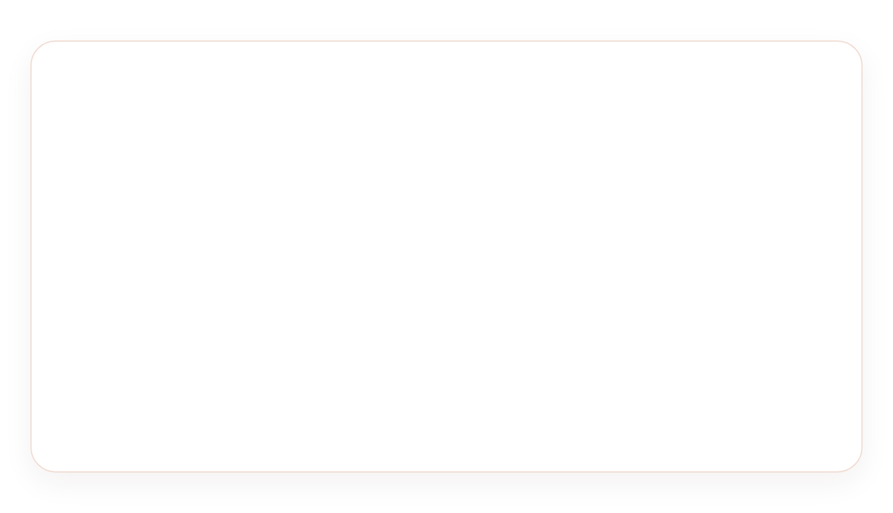











PAID STRATEGY — LEAN & ORGANIC-FIRST
Paid Ads Strategy —
Lean Approach
Unfunded = Organic priority
Lean Media Plan
₹15k-25k/mo
EXPECTED ROAS
SCALE AFTER
2–3x
→ 4x at 6M
BUDGET
₹15,000–₹25,000 / month — organic-first
Start lean, let organic drive 80% reach. Paid is amplifier, not engine.
AUDIENCE
Women 18–28, Tier 1 & 2, interests: makeup, creators
LOOKALIKE
Website visitors + IG engagers → 1% LAL
CREATIVE FORMAT THAT WORKS
UGC phone-shot reviews — authentic
BIDDING
Cost Cap conversions, Traffic to build pixel
Founder direct camera — product in hand
CREATIVE
UGC reels, founder videos, before/after
Before/After lip transformation
PLACEMENT
IG Reels + Stories primary, FB secondary
Note: Unfunded → priority organic via 5.5M + UGC.

Slide 16
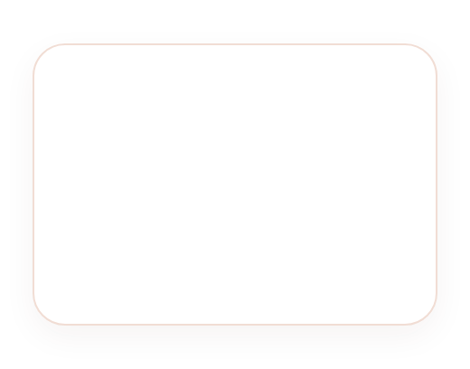

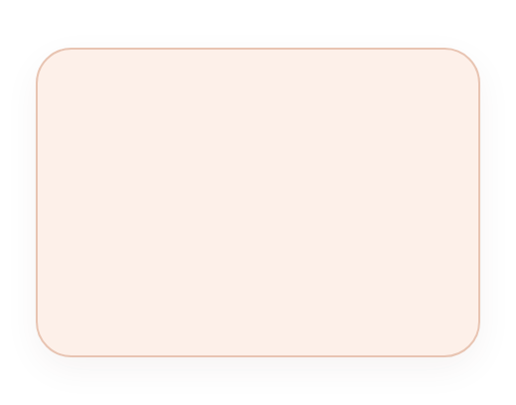










KPI DASHBOARD + FORECAST
KPIs — Kya Measure Karein?
₹2Cr in 5 months = strong PMF proof.
Leverage 5.5M audience for organic scale → lean paid.
CORE
GROWTH
TRAFFIC
CVR
PAID
ENGAGEMENT RATE
BRAND FOLLOWERS
WEBSITE VISITS
CONVERSION RATE
ROAS
1.5-2% now
~50K
2K/mo
1-1.5%
— new pixel
3M
3.5%
3M
100K
3M
8K
3M
2.5%
3M
2.5x
6M
5%
6M
200K
6M
15K
6M
3.5%
6M
4x
FORECAST LOGIC — WHY TARGETS ACHIEVABLE
EXPECTED FUNNEL IMPACT
5.5M audience = free reach & pixel warm-up
UGC + Circle drives organic 2x
Reel views 5-10K → 50K
5x
Skincare-infused differentiates
₹2Cr proof = PMF, 294 reviews
Repeat 15% → 25%
+67%
Organic drives 70% traffic
Lean

Slide 17
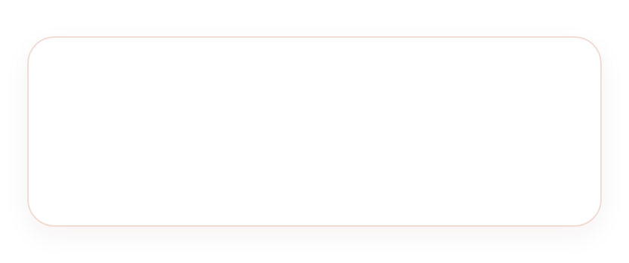



LEARNING & CONCLUSION
Seekh + Conclusion
LEARNING 01
LEARNING 02
LEARNING 03
Creator trust = power
Product hi marketing hai
Sasta + Aspirational possible
5.5M followers sirf audience nahi — ready-made testing group. Brand sunta hai, bolta nahi. Yahi taakat.
Skincare-infused formula har use pe promise yaad dilata hai. 294 reviews on Brew = deep engagement.
Gen Z ko Western vibe @ ₹499 chahiye. Mrucha ne ₹389-₹1,649 me premium feel diya.
FINAL TAKEAWAY
Mrucha sirf “Mrunal ka brand” nahi — Gen Z beauty powerhouse ban sakta hai.
Bas community ko sunna hai, product achha rakhna hai, consistently content banana hai.
Mrucha Beauty — 1 saal me kamaal
₹2 Crore sales in 5 months + Hurun India Top Founder Ranking + Loyal Mrucha Circle
Aage: #MruchaCircle strong, feedback se new shades, brand ki apni pehchaan Mrunal ke alawa
Playbook: Consistent content + UGC + lean paid (₹15-25k/mo)
₹2Cr
6M
#Circle
SALES
COMMUNITY
MOAT
Raheen Pathan — Sep 2026
Submitted to Mr. Sanchit Khandelwal
mrucha.com
Case Study • Skincare-Infused Makeup for Indian Skin Tones

Slide 18
✨
Thank You
—
For being part of our #MruchaCircle
Your trust makes us beautiful
Made with ♡ for Indian Skin Tones

